Slide 2
What is Neural Network?

Slide 3
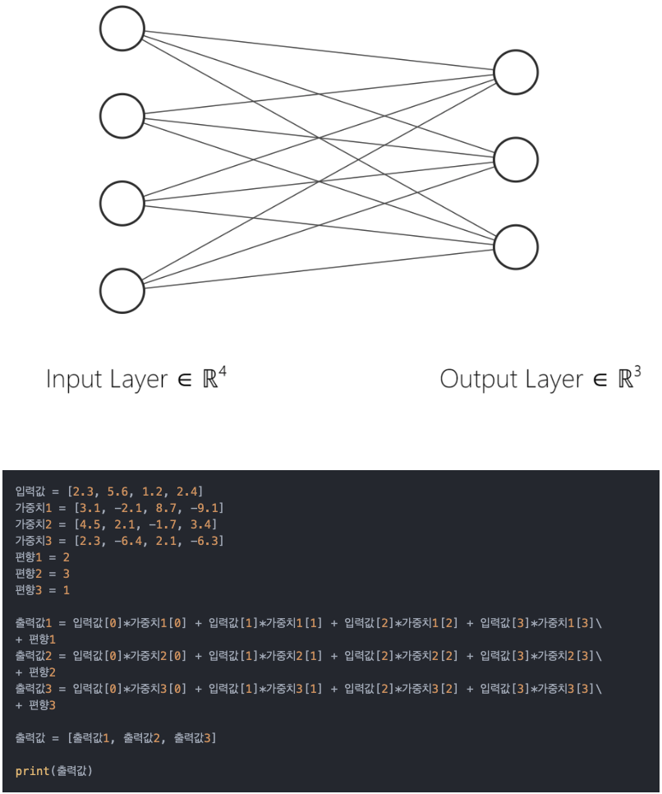
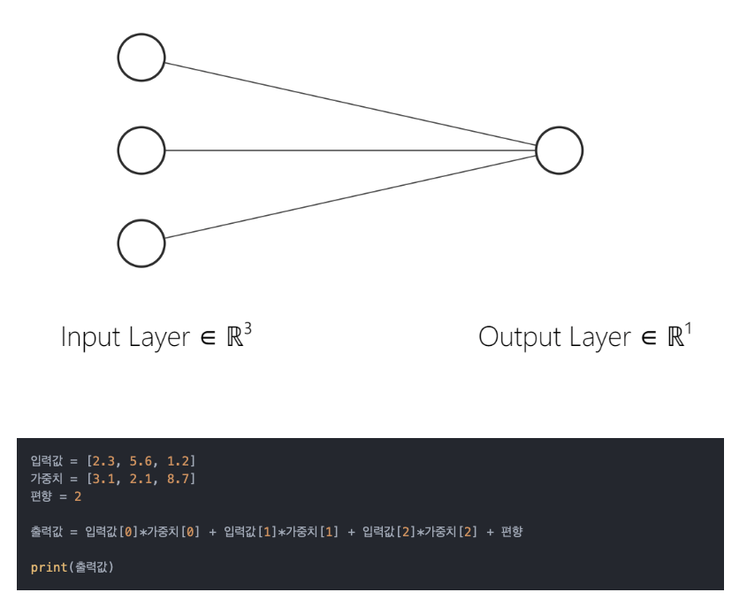
Neural Network - 1
https://nobsai.tistory.com/8

Slide 4
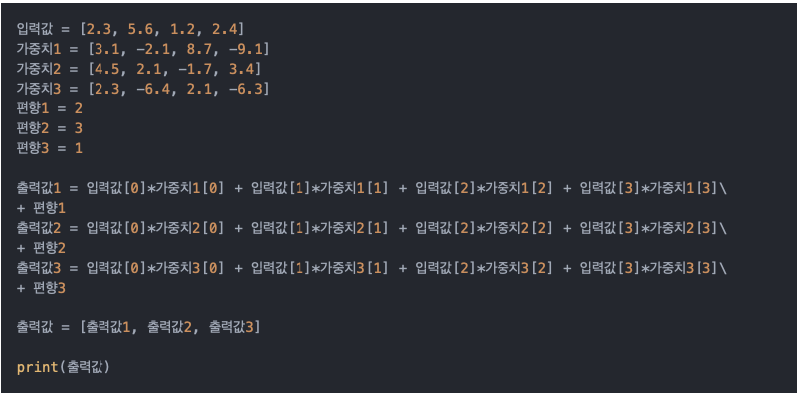
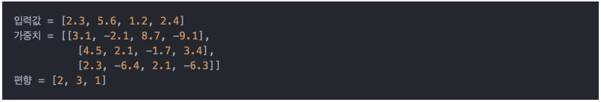
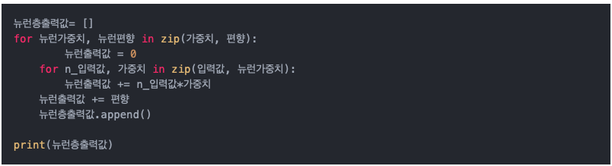
Neural Network - 2
https://nobsai.tistory.com/8

Slide 5
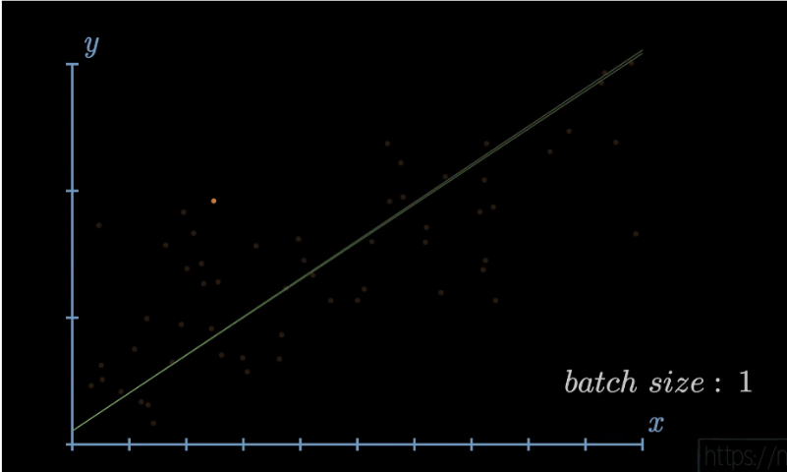
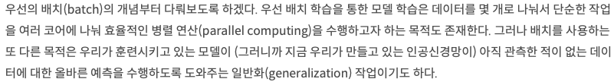
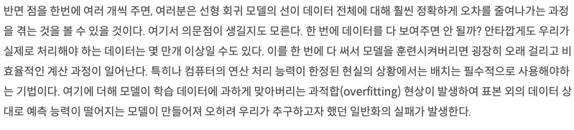
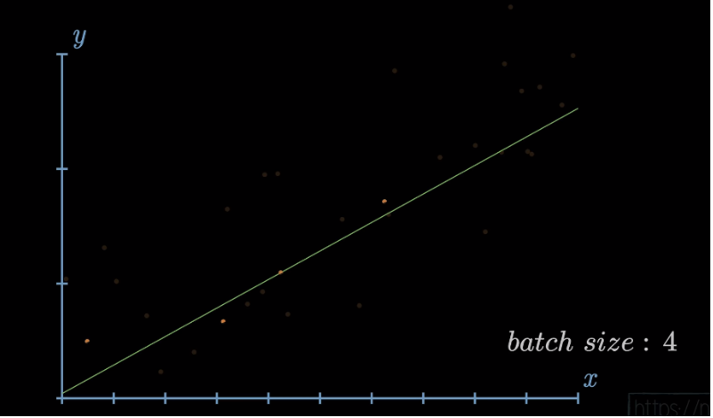
Neural Network - 3
What is batch?
https://nobsai.tistory.com/8

Slide 6
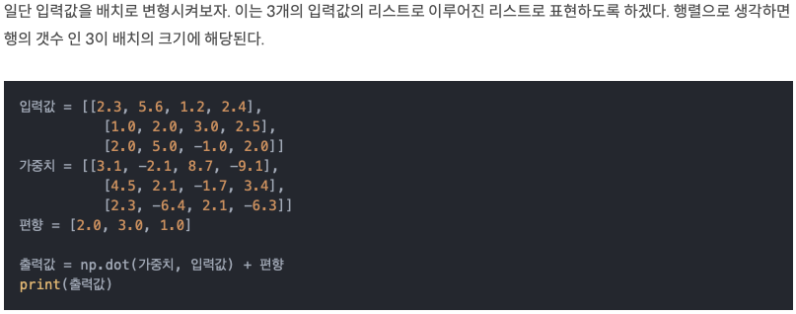
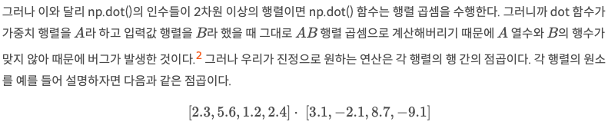
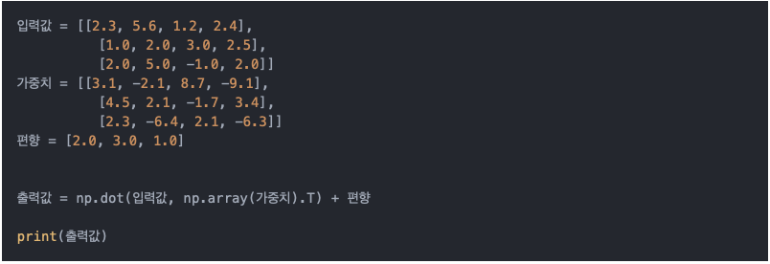
Neural Network - 4
Error!
https://nobsai.tistory.com/8

Slide 7
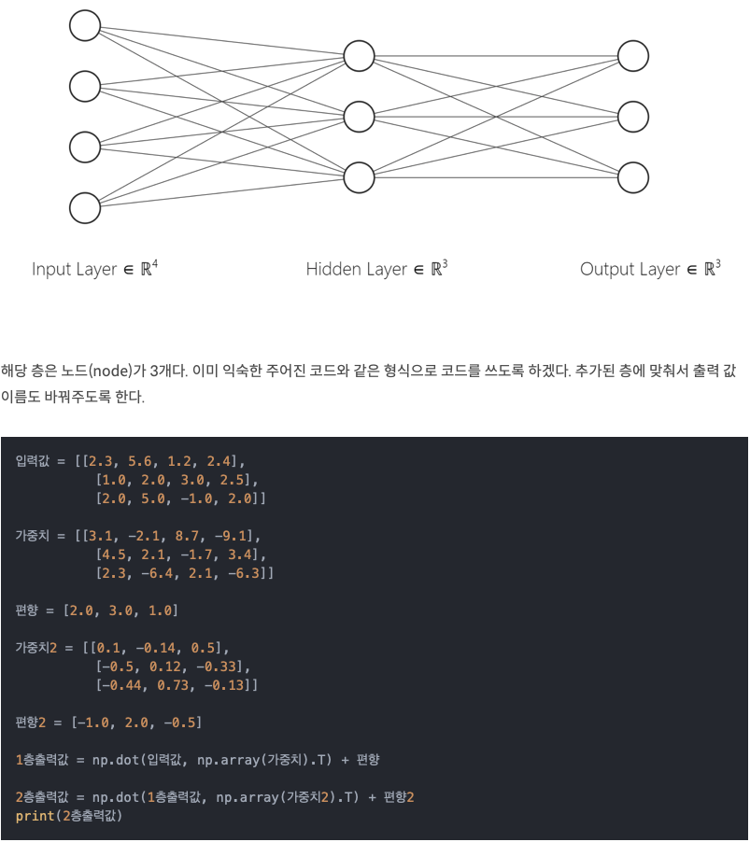
Neural Network - 5
https://nobsai.tistory.com/8

Slide 8
What is MLP?

Slide 9
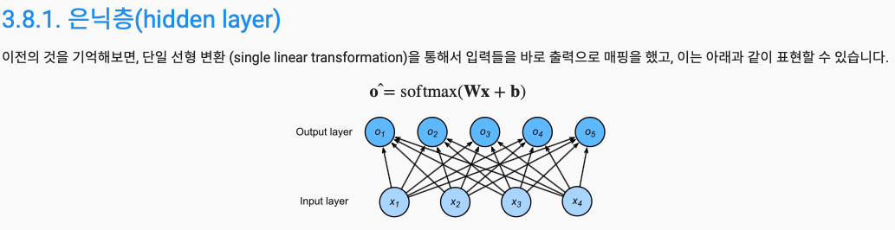
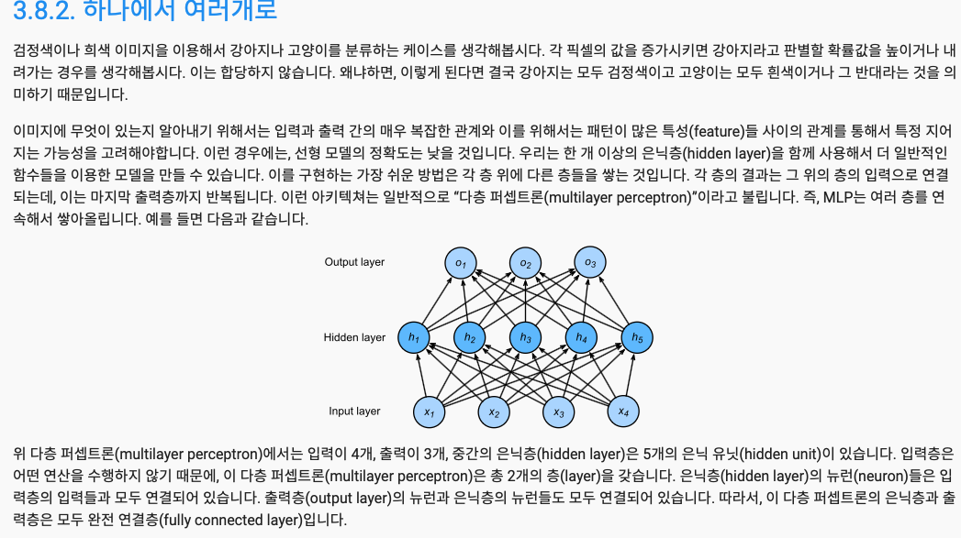
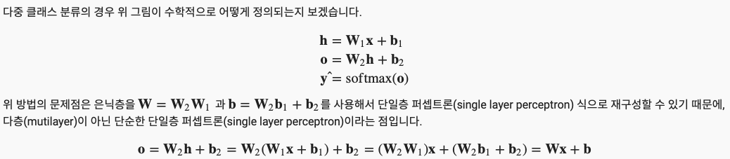
MLP(Multilayer Perceptron)
https://ko.d2l.ai/chapter_deep-learning-basics/mlp.html

Slide 10
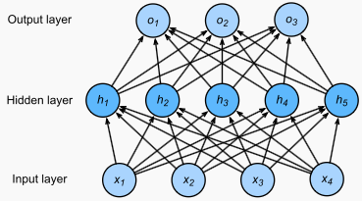
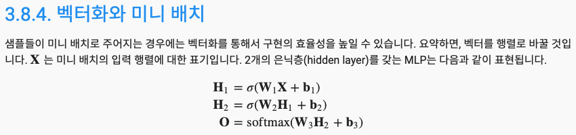
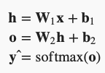

MLP(Multilayer Perceptron)
https://ko.d2l.ai/chapter_deep-learning-basics/mlp.html

Slide 11
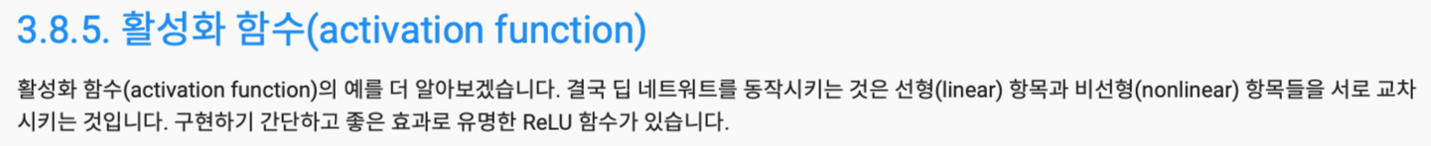
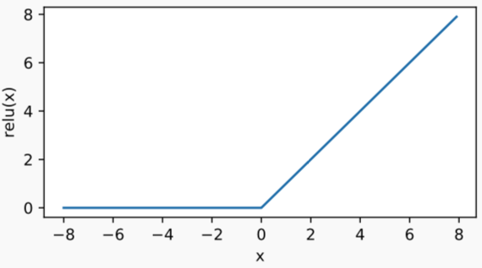
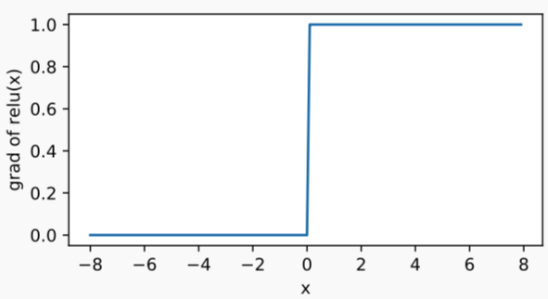
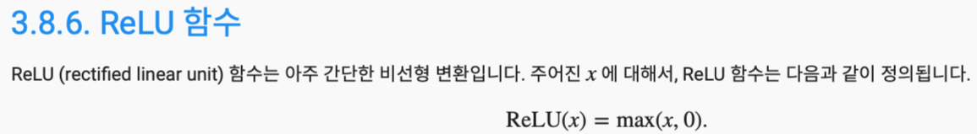
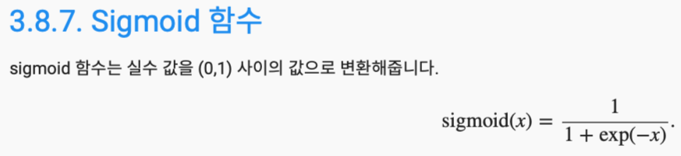
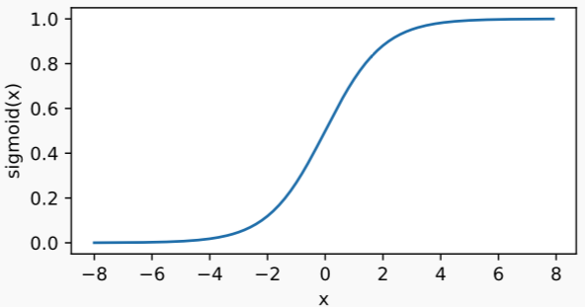
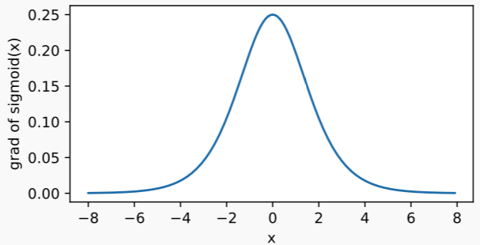

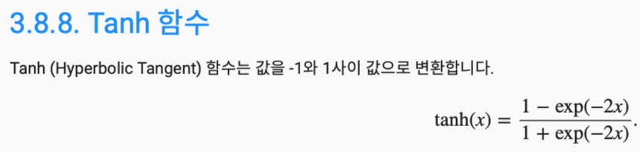
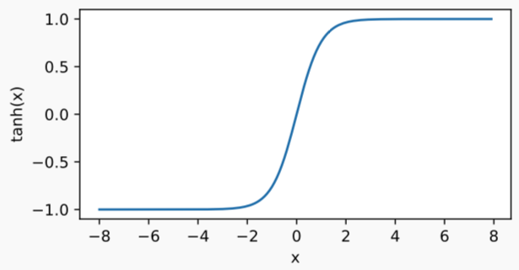
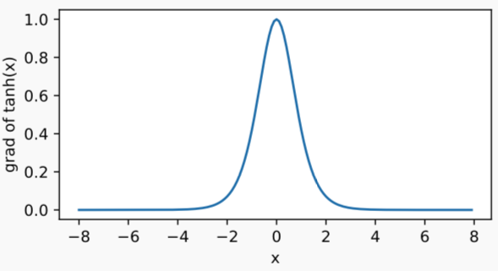

Perceptron
https://ko.d2l.ai/chapter_deep-learning-basics/mlp.html

Slide 12
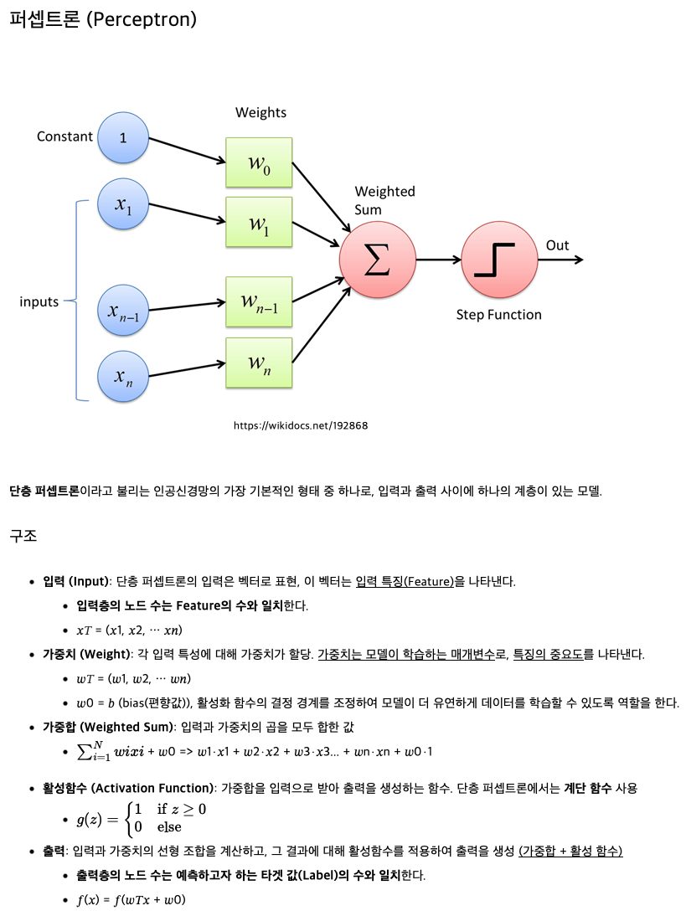
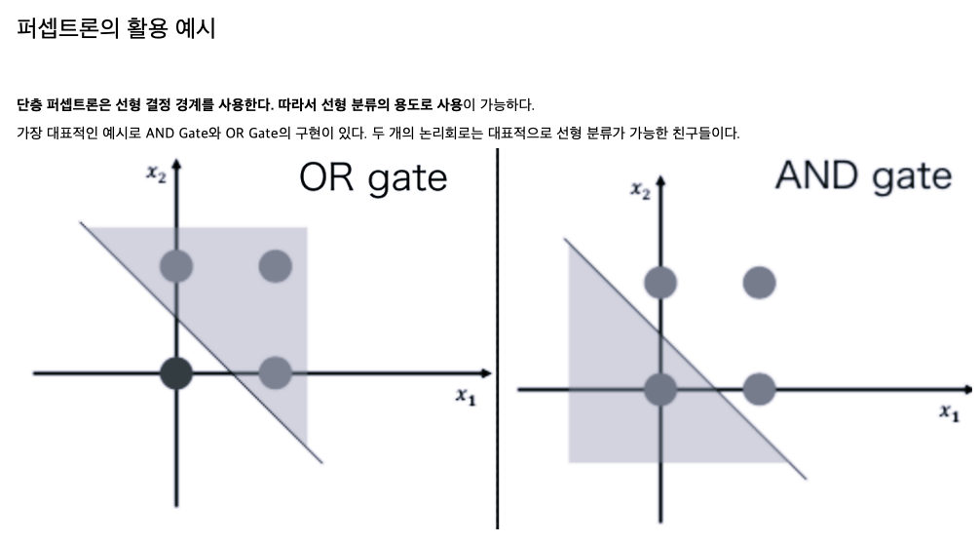
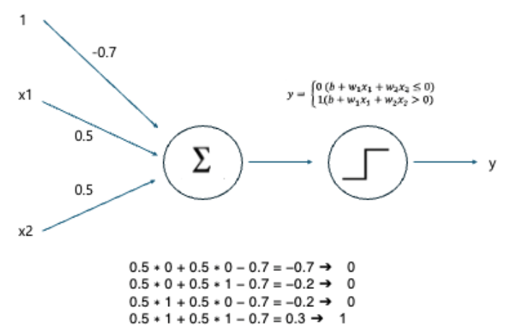
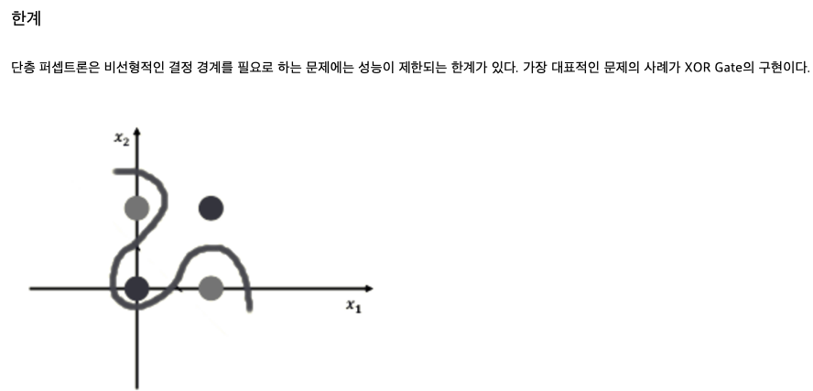
Perceptron
https://sjh9708.tistory.com/225

Slide 13
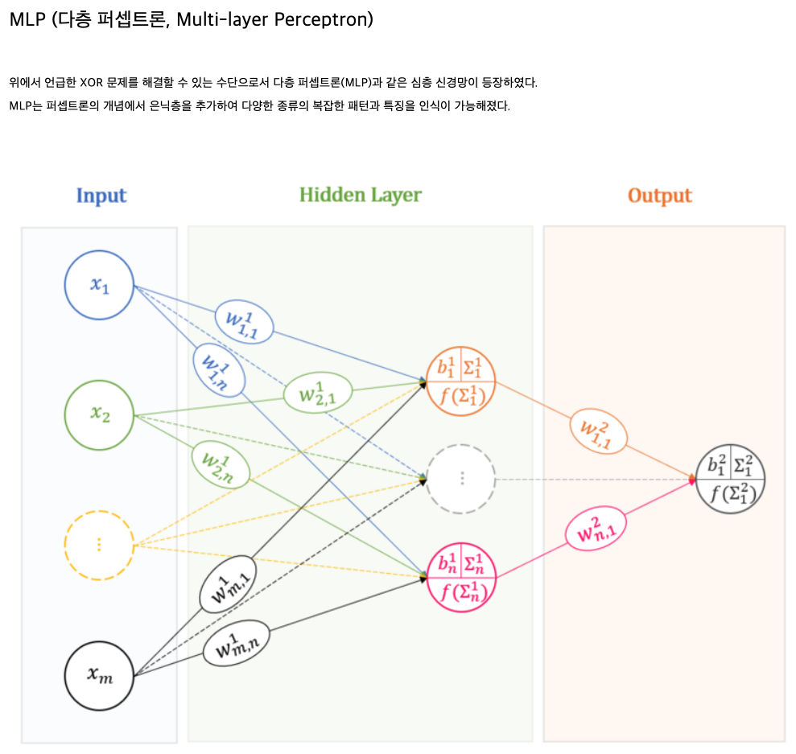
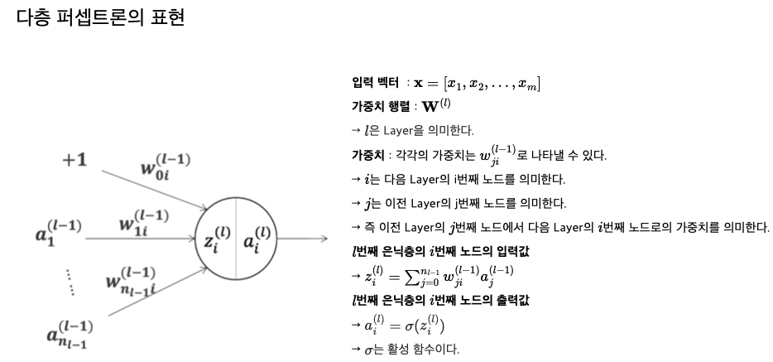
MLP(Multilayer Perceptron)
https://sjh9708.tistory.com/225

Slide 14
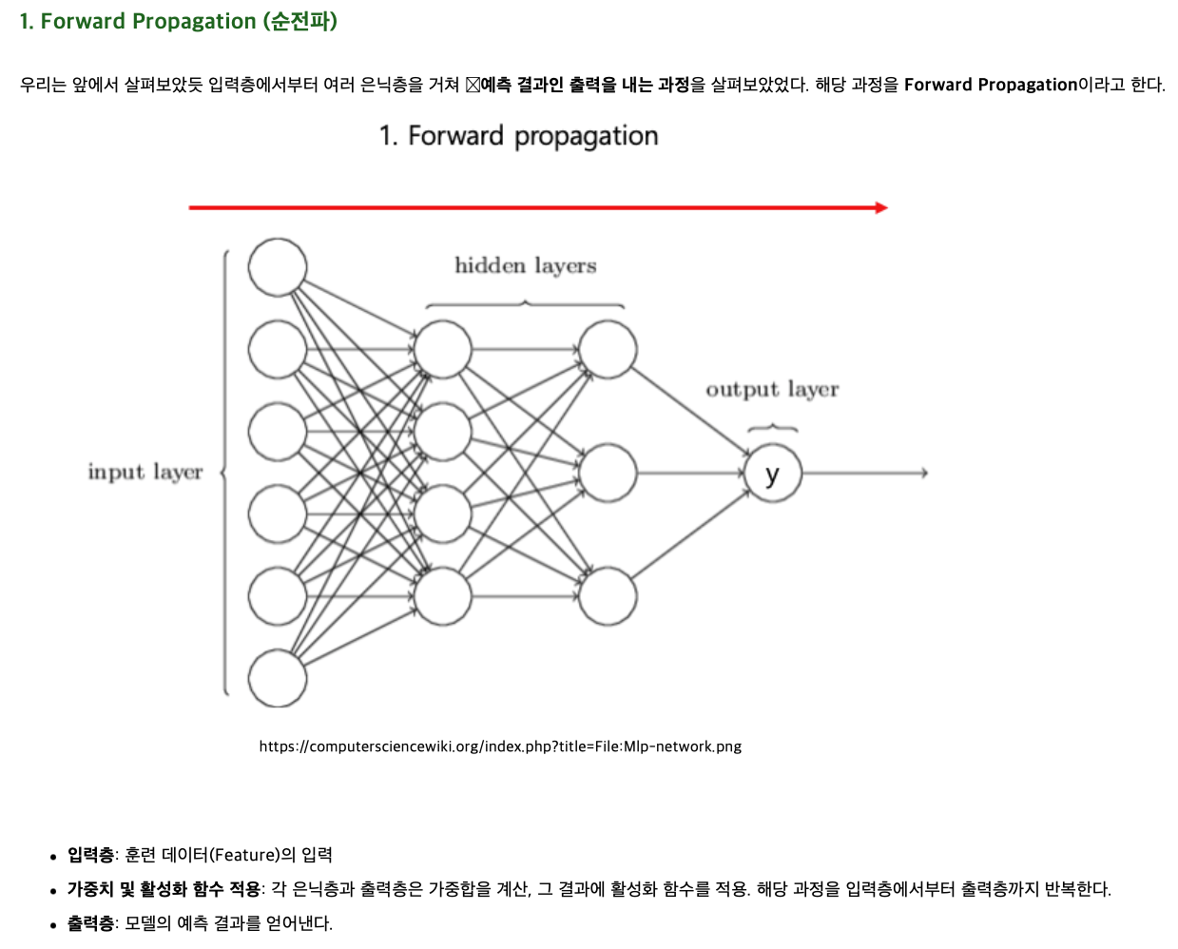
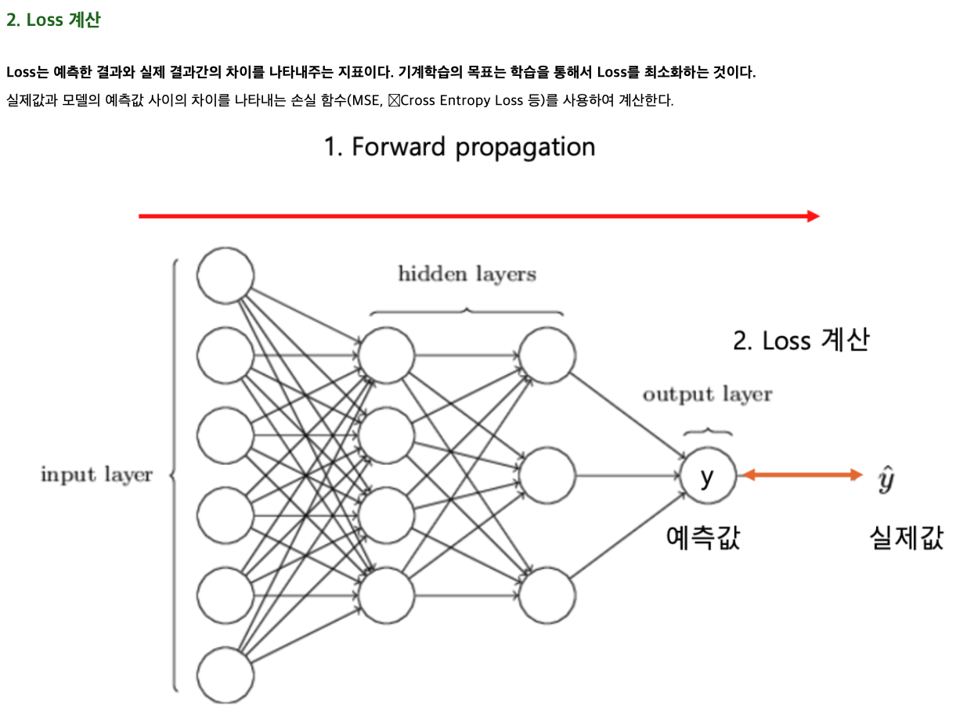
MLP – What is output?
https://sjh9708.tistory.com/225

Slide 15
Loss function

Slide 16
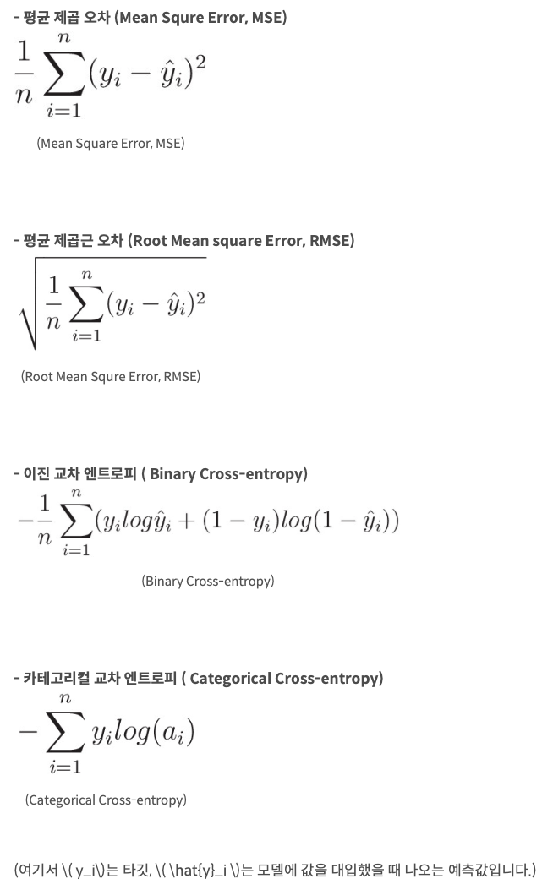
MLP – Loss functions
https://yhyun225.tistory.com/5
https://en.wikipedia.org/wiki/Loss_function

Slide 17
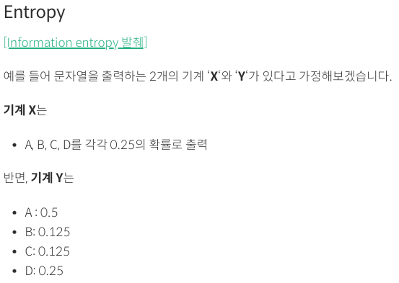
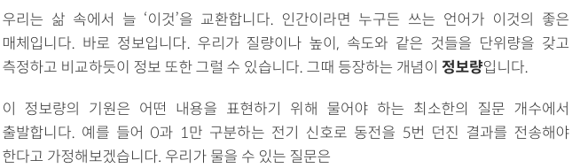
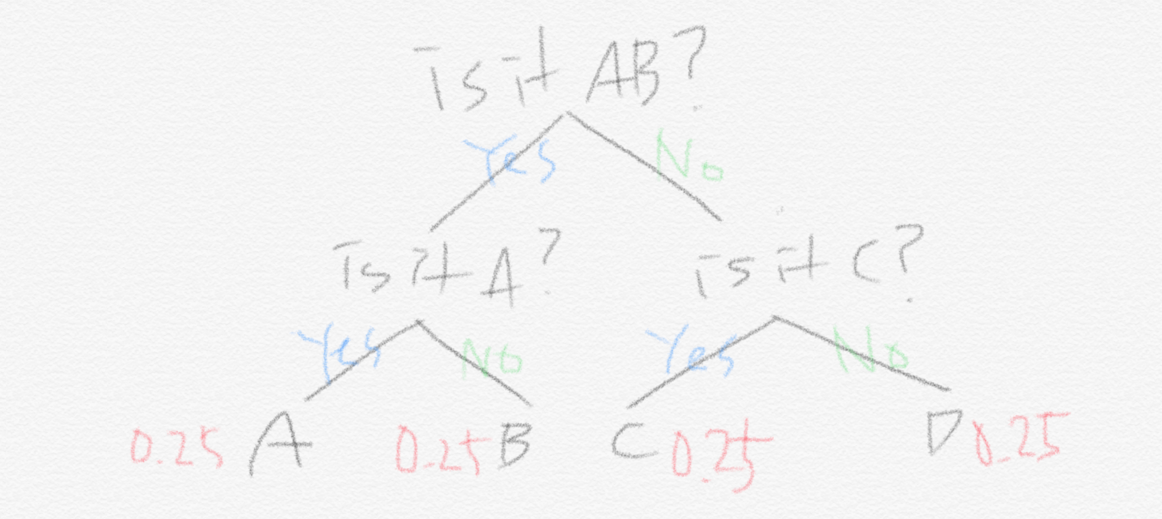
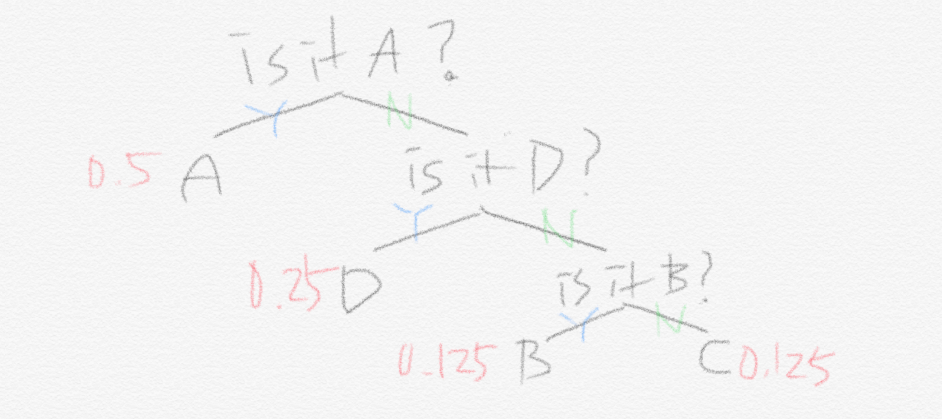
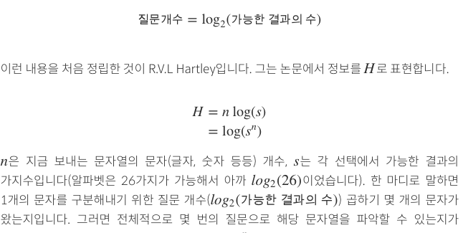
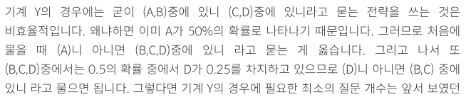
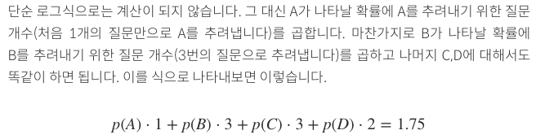
MLP – Entropy
https://hyunw.kim/blog/2017/10/14/Entropy.html

Slide 18
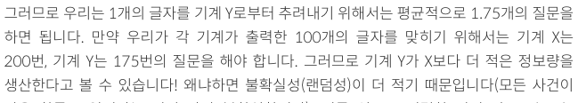
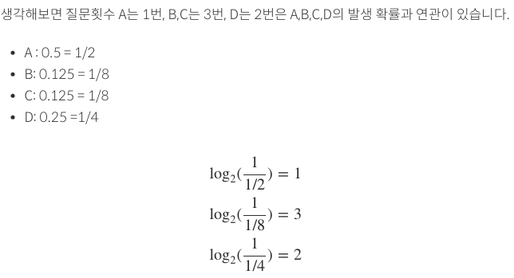
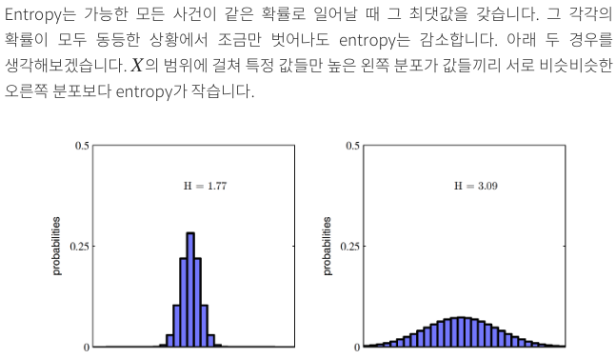
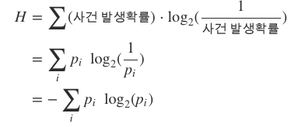
MLP – Entropy
Claude Shannon의 Entropy
질문 횟수
https://hyunw.kim/blog/2017/10/14/Entropy.html

Slide 19
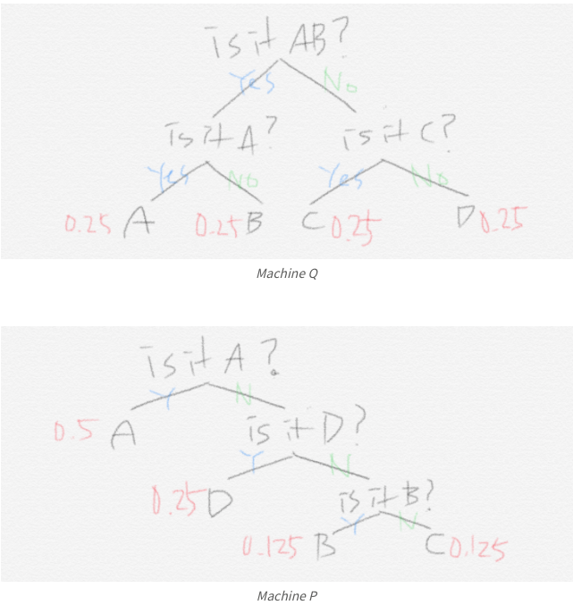


MLP – Cross Entropy
https://hyunw.kim/blog/2017/10/14/Entropy.html

Slide 20







MLP – Cross Entropy
Weight를 학습시켜 나가자
연속형 확률분포에서는
https://hyunw.kim/blog/2017/10/14/Entropy.html

Slide 21




MLP – KL-divergence
https://hyunw.kim/blog/2017/10/14/Entropy.html

Slide 22

MLP – KL-divergence
https://hyunw.kim/blog/2017/10/14/Entropy.html

Slide 23
How to train?

Slide 24



MLP – How to train?
가중치에 대한 차원
https://yhyun225.tistory.com/5
https://en.wikipedia.org/wiki/Loss_function

Slide 25

MLP – How to train?
https://sjh9708.tistory.com/225

Slide 26


MLP – How to train?
https://sjh9708.tistory.com/225

Slide 27



MLP – How to train?
https://nanunzoey.tistory.com/entry/딥러닝-오차역전파Back-propagation-직접-계산하기

Slide 28



MLP – How to train?
https://nanunzoey.tistory.com/entry/딥러닝-오차역전파Back-propagation-직접-계산하기

Slide 29


MLP – How to train?
https://nanunzoey.tistory.com/entry/딥러닝-오차역전파Back-propagation-직접-계산하기

Slide 30
Dual problem

Slide 31



Dual problem
$$↔$$
dual

